Slide 1
Ecommerce store
Васил Райков

Slide 2
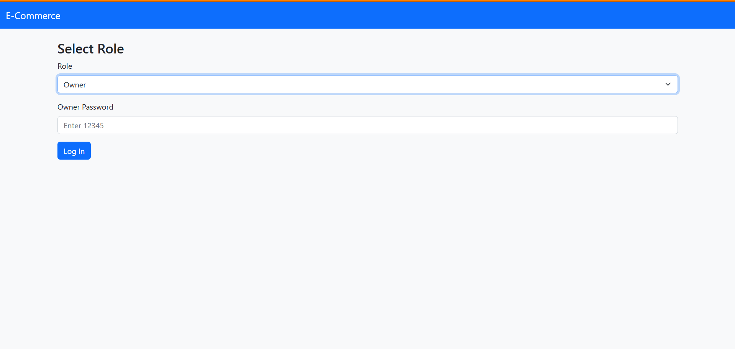


Slide 3
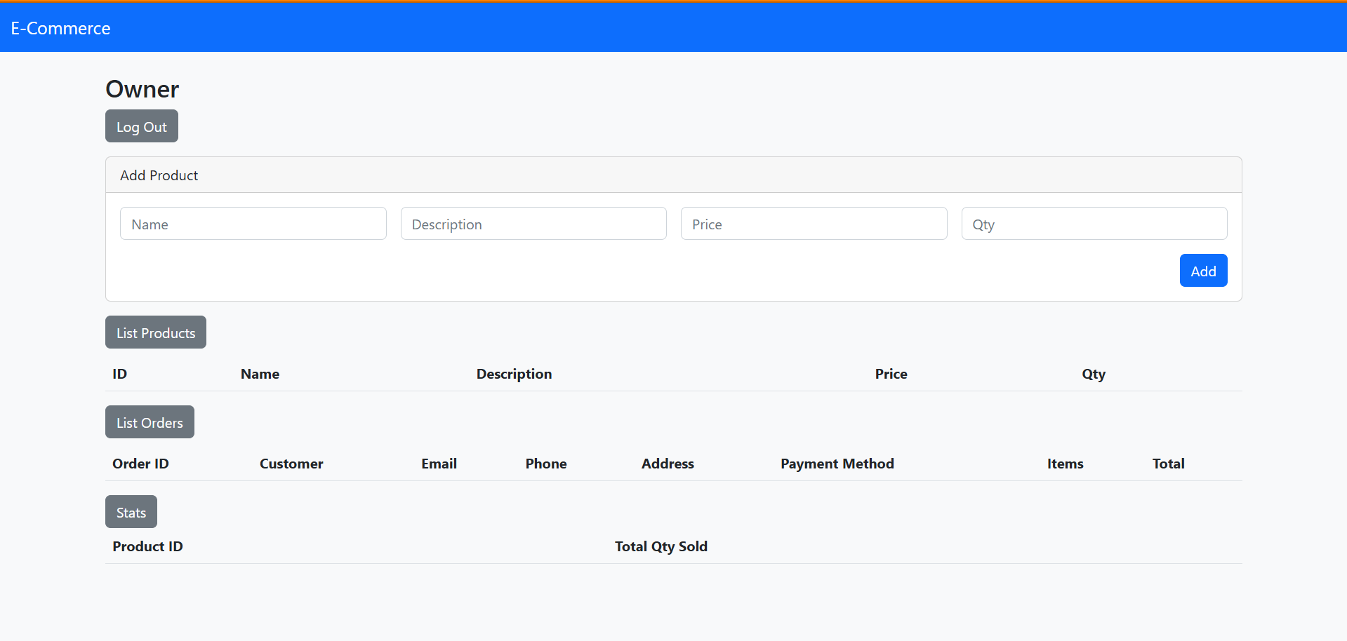
Owner page

Slide 4
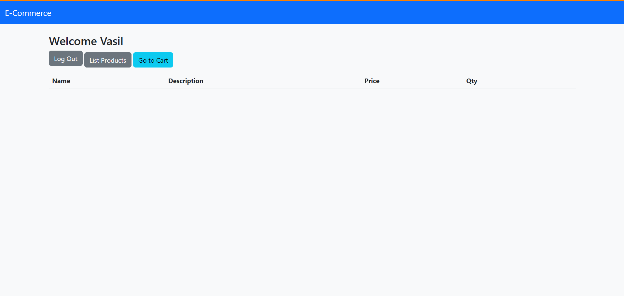
Customer page

Slide 5
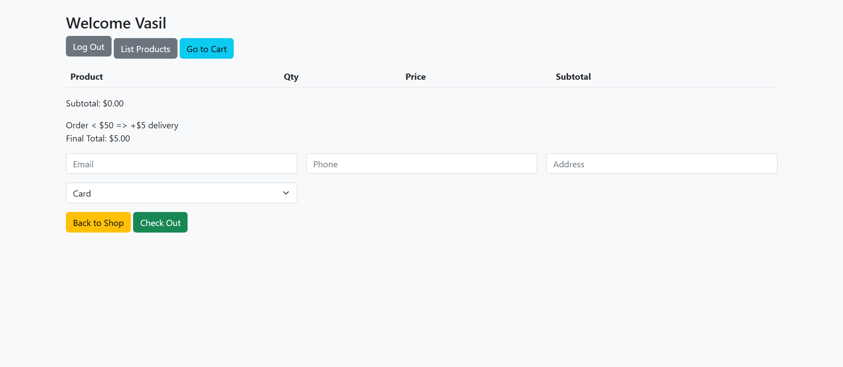
Shopping cart

